Slide 1
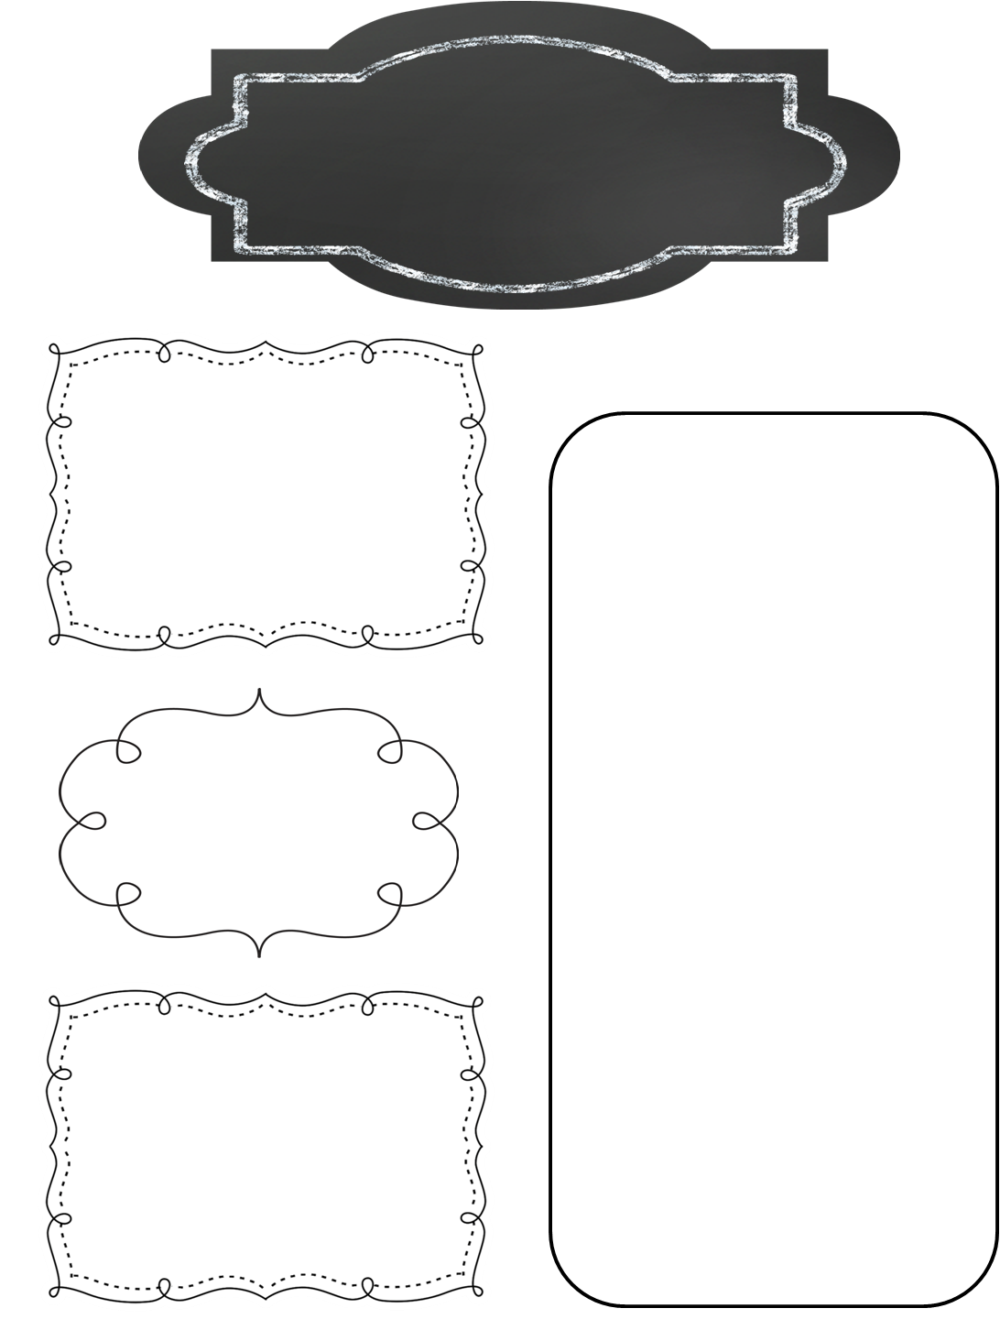
A Peek at This Week in…
Mrs. McFarland’s Class
Week of December 9th
Reminders
We earned the attendance award for November, so students may bring electronic devices from home to play on during study hall (approximately 30 min.) this Friday. They will not have access to Wifi so keep that in mind.
Our holiday party is quickly approaching. These parents/guardians signed up to help: Mrs. Hawkins, snacks; Mrs. Rovey-drinks; and Mrs. Wainscott-game/craft. I need one other helper to do treat bags, please and thank you. We have 22 students.
Math (McFarland)
Chapter 12: Geometry
Area/Perimeter
Volume
Test next Tuesday
Reading (McFarland)
Cat research
They did it! Our homeroom won 1st place in the multiplication math fact competition! I’m so proud of them! Thank you, parents and guardians, for helping your student!
Spelling (McFarland)
No spelling this week!
Language Arts/Writing (McFarland)
U2L10 Language test Tuesday (tomorrow)
Cats compare/contrast essay
Interrupted quotations with interjections
Verb tenses
Finish fairytale compare/contrast essay
Finish narrative
Upcoming Events
Thursday, December 12th: Last day of after school tutoring until after break
Tuesday, December 17th: NMIS Christmas program 6:00 pm (NOTE TIME CHANGE!)
Wednesday, December 18th: Board meeting
Thursday, December 19th: 12:30 PBIS movie reward
Friday, December 20th: End of quarter 2, dismissal @ 1:30 for break!
Science/ Social Studies (Eldridge)
Science: Ch. 4 Ecosystems
Social Studies: N/A

